Slide 1
Configuration Model Properties Giant Component
MA 653: Network Science
Instructor: Ashok Singh Sairam
ashok@iitg.ac.in

Slide 2
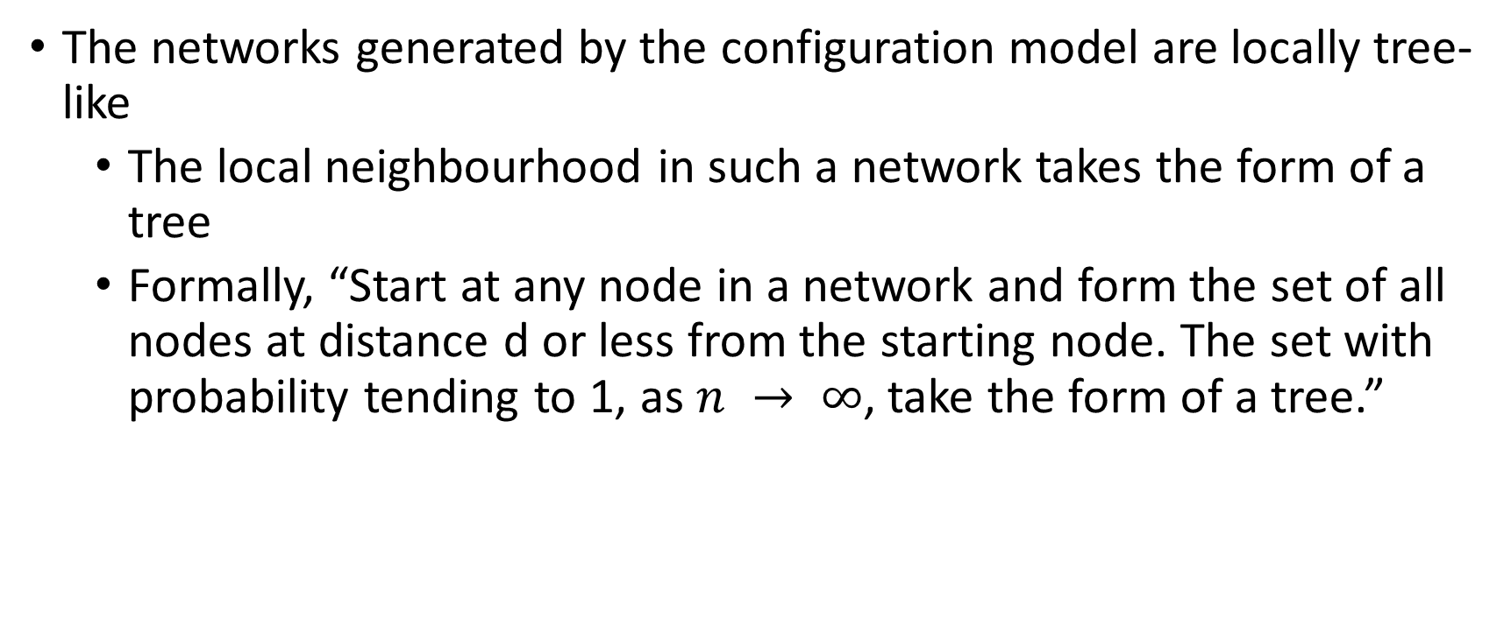
Locally Tree-like Networks
The networks generated by the configuration model are locally tree-like
The local neighbourhood in such a network takes the form of a tree
Formally, “Start at any node in a network and form the set of all nodes at distance d or less from the starting node. The set with probability tending to 1, as $n → ∞$, take the form of a tree.”

Slide 3
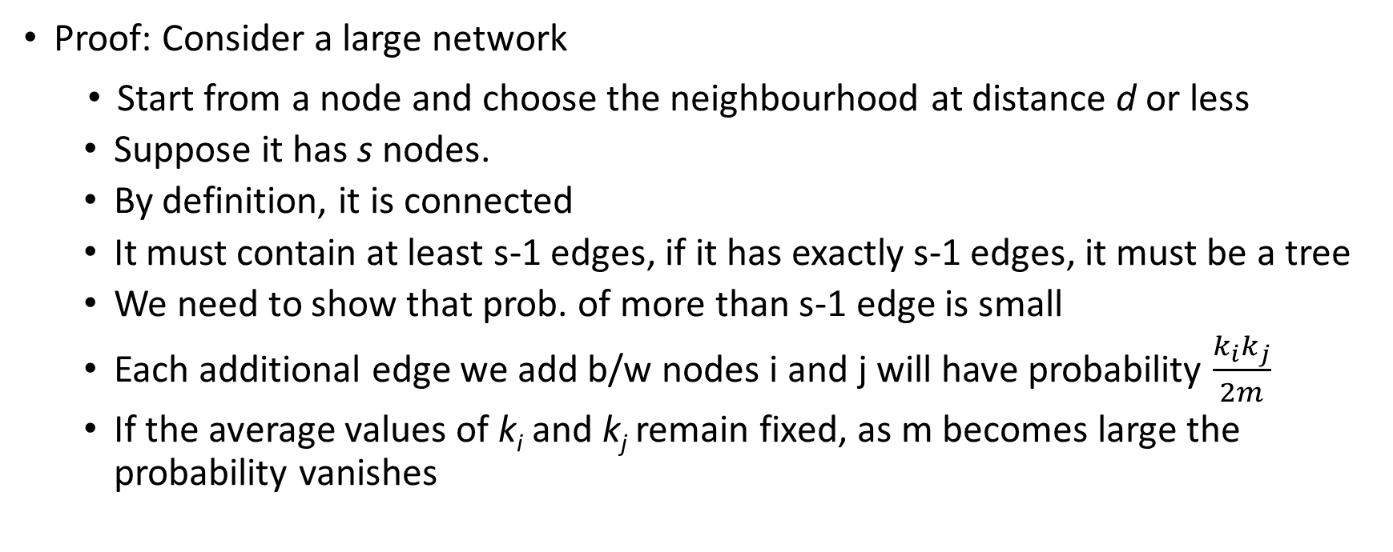
Locally Tree-like Networks: Proof
Proof: Consider a large network
Start from a node and choose the neighbourhood at distance d or less
Suppose it has s nodes.
By definition, it is connected
It must contain at least s-1 edges, if it has exactly s-1 edges, it must be a tree
We need to show that prob. of more than s-1 edge is small
Each additional edge we add b/w nodes i and j will have probability $\frac{k_{i}k_{j}}{2m}$
If the average values of k_{i} and k_{j} remain fixed, as m becomes large the probability vanishes

Slide 4
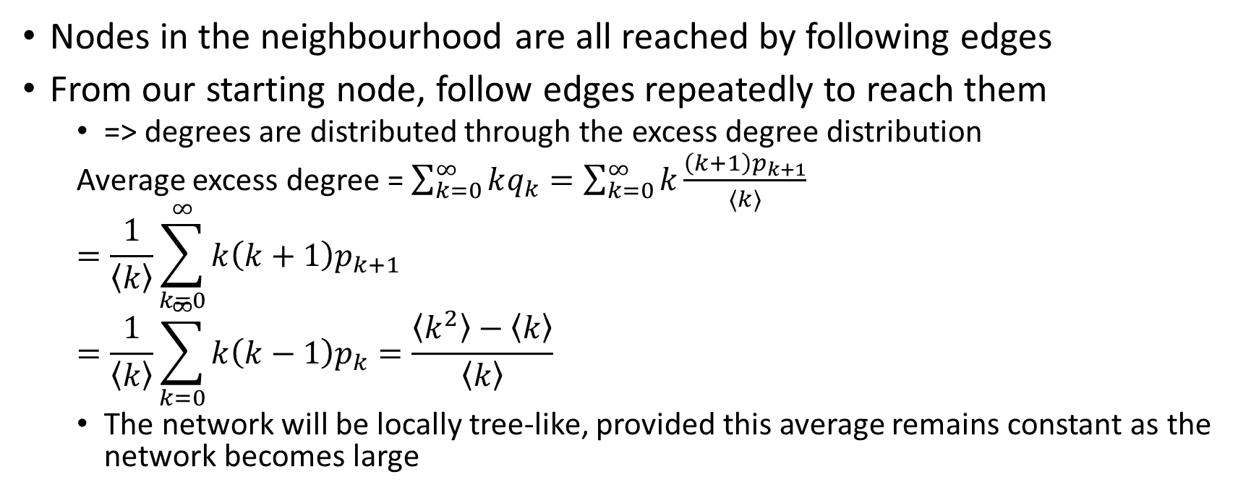
Locally Tree-like Networks: Proof continued
Nodes in the neighbourhood are all reached by following edges
From our starting node, follow edges repeatedly to reach them
=> degrees are distributed through the excess degree distribution
Average excess degree = $\sum_{k=0}^{∞}{kq_{k}}=\sum_{k=0}^{∞}{k\frac{\left(k+1\right)p_{k+1}}{\left\langle k\right\rangle }}$
$$=\frac{1}{\left\langle k\right\rangle }\sum_{k=0}^{∞}{k\left(k+1\right)p_{k+1}}$$
$$=\frac{1}{\left\langle k\right\rangle }\sum_{k=0}^{∞}{k\left(k−1\right)p_{k}=\frac{\left\langle k^{2}\right\rangle −\left\langle k\right\rangle }{\left\langle k\right\rangle }}$$
The network will be locally tree-like, provided this average remains constant as the network becomes large

Slide 5

Number of second neighbours of a node
Because local neighborhoods take the form of a tree, the number of second neighbours of a node i
Sum of the excess degree of the first neighbours
i
$$k_{i}$$
1st Neighbour
2nd Neighbour

Slide 6
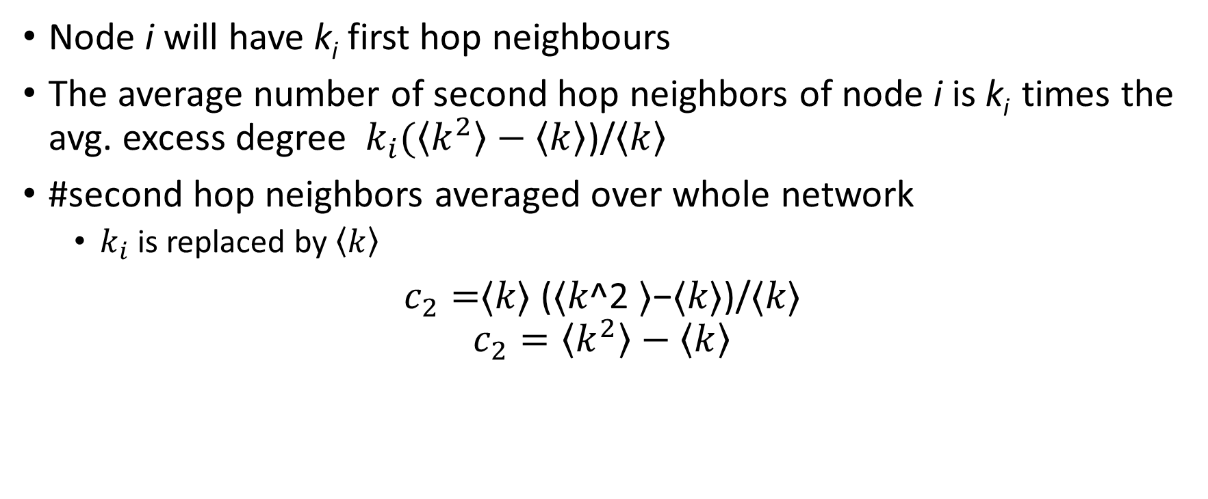
Number of second neighbours of a node
Node i will have k_{i} first hop neighbours
The average number of second hop neighbors of node i is k_{i} times the avg. excess degree $k_{i}(\left\langle k^{2}\right\rangle −\left\langle k\right\rangle$)/$\left\langle k\right\rangle$
#second hop neighbors averaged over whole network
$k_{i}$ is replaced by $\left\langle k\right\rangle$
$c_{2}=$⟨𝑘⟩ (⟨𝑘^2 ⟩−⟨𝑘⟩)/⟨𝑘⟩
$$c_{2}=\left\langle k^{2}\right\rangle −\left\langle k\right\rangle$$

Slide 7
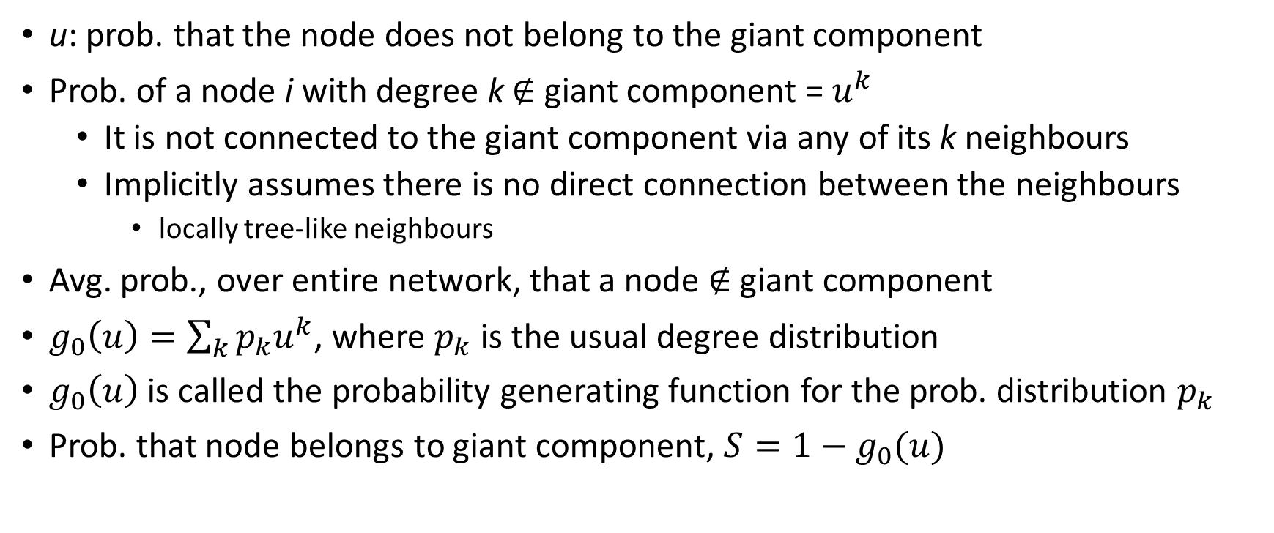
Giant component
u: prob. that the node does not belong to the giant component
Prob. of a node i with degree k $∉$ giant component = $u^{k}$
It is not connected to the giant component via any of its k neighbours
Implicitly assumes there is no direct connection between the neighbours
locally tree-like neighbours
Avg. prob., over entire network, that a node $∉$ giant component
$g_{0}\left(u\right)=\sum_{k}{p_{k}u^{k}}$, where $p_{k}$ is the usual degree distribution
$g_{0}\left(u\right)$ is called the probability generating function for the prob. distribution $p_{k}$
Prob. that node belongs to giant component, $S=1−g_{0}(u)$

Slide 8
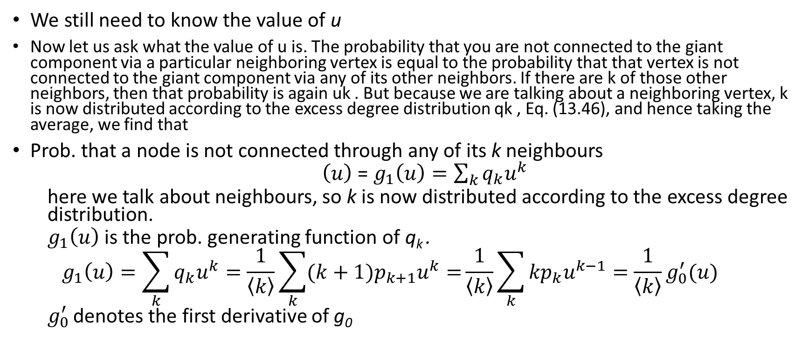
We still need to know the value of u
Now let us ask what the value of u is. The probability that you are not connected to the giant component via a particular neighboring vertex is equal to the probability that that vertex is not connected to the giant component via any of its other neighbors. If there are k of those other neighbors, then that probability is again uk . But because we are talking about a neighboring vertex, k is now distributed according to the excess degree distribution qk , Eq. (13.46), and hence taking the average, we find that
Prob. that a node is not connected through any of its k neighbours
$\left(u\right)$ = $g_{1}\left(u\right)=\sum_{k}{q_{k}u^{k}}$
here we talk about neighbours, so k is now distributed according to the excess degree distribution.
$g_{1}\left(u\right)$ is the prob. generating function of q_{k} .
$$g_{1}\left(u\right)=\sum_{k}{q_{k}u^{k}}=\frac{1}{\left\langle k\right\rangle }\sum_{k}{({k+1)p}_{k+1}u^{k}=}\frac{1}{\left\langle k\right\rangle }\sum_{k}{{kp}_{k}u^{k−1}=\frac{1}{\left\langle k\right\rangle }g_{0}^{′}(u)}$$
$g_{0}^{′}$ denotes the first derivative of g₀

Slide 9
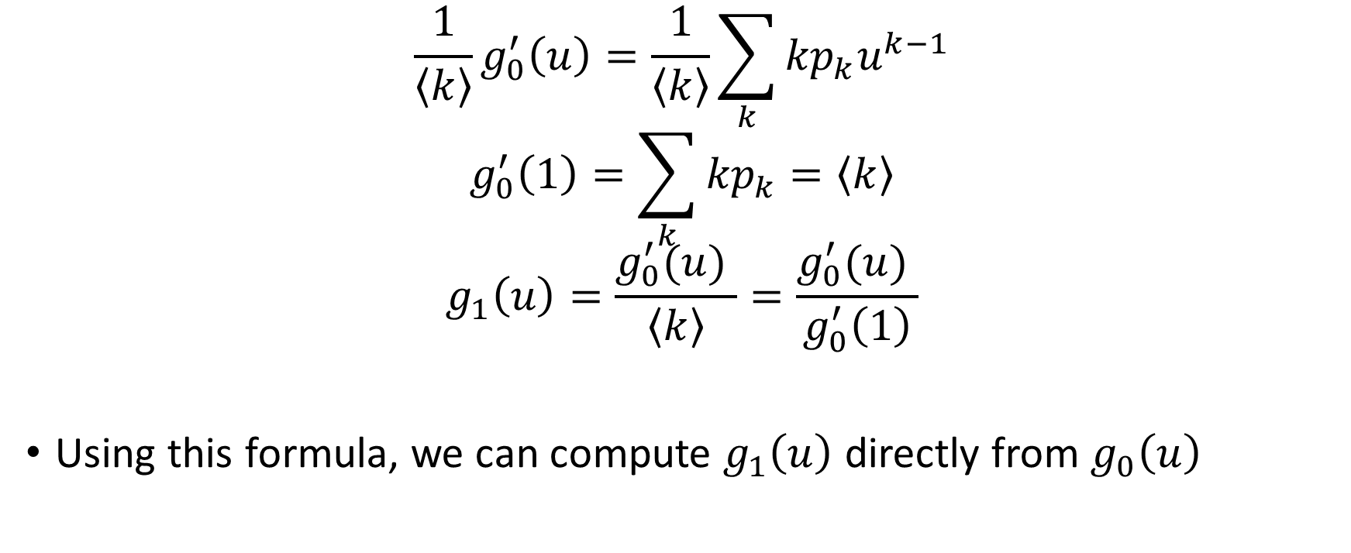
$$\frac{1}{\left\langle k\right\rangle }g_{0}^{′}\left(u\right)=\frac{1}{\left\langle k\right\rangle }\sum_{k}{{kp}_{k}u^{k−1}}$$
$$g_{0}^{′}\left(1\right)=\sum_{k}{{kp}_{k}}=\left\langle k\right\rangle$$
$$g_{1}\left(u\right)=\frac{g_{0}^{′}(u) }{\left\langle k\right\rangle }=\frac{g_{0}^{′}(u) }{g_{0}^{′}\left(1\right)}$$
Using this formula, we can compute $g_{1}\left(u\right)$ directly from $g_{0}\left(u\right)$

Slide 10
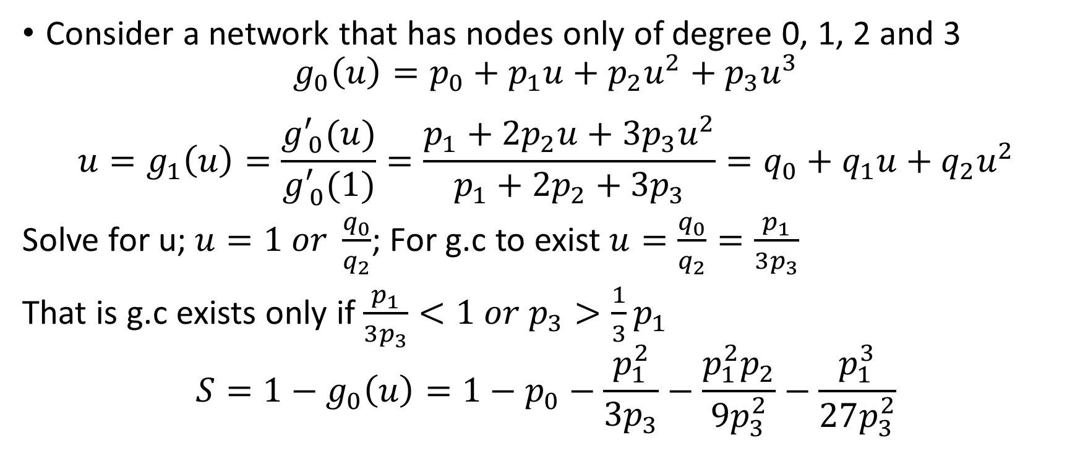
Example: Giant component
Consider a network that has nodes only of degree 0, 1, 2 and 3
$$g_{0}\left(u\right)=p_{0}+p_{1}u+p_{2}u^{2}+p_{3}u^{3}$$
$$u=g_{1}\left(u\right)=\frac{g_{ 0}^{′}(u)}{g_{ 0}^{′}(1)}=\frac{p_{1}+{2p}_{2}u+{3p}_{3}u^{2}}{p_{1}+{2p}_{2}+{3p}_{3}}=q_{0}+q_{1}u+q_{2}u^{2}$$
Solve for u; $u=1 or \frac{q_{0}}{q_{2}}$; For g.c to exist $u=\frac{q_{0}}{q_{2}}=\frac{p_{1}}{3p_{3}}$
That is g.c exists only if $\frac{p_{1}}{3p_{3}}<1 or p_{3}>\frac{1}{3}p_{1}$
$$S=1−g_{0}\left(u\right)=1−p_{0}−\frac{p_{1}^{2}}{3p_{3}}−\frac{p_{1}^{2}p_{2}}{9p_{3}^{2}}−\frac{p_{1}^{3}}{27p_{3}^{2}}$$

